Slide 1


Slide 2


Slide 3



Our journey
The methods
  Machine learning vs generative AI
  Supervised learning methods
  Unsupervised learning methods
  Generative methods
    Large Language Models
The limits
  Interpretability and transparency of the models
  Bias in data and algorithms
  Hallucination

Slide 4
Machine Learning
Learning from data
ML focuses on developing algorithms that can learn from data and make predictions or decisions without being explicitly programmed
Learning Approach
ML relies on training models with labeled data (supervised learning) or finding patterns in unlabeled data (unsupervised learning) to perform specific tasks
Examples
Classification, regression, clustering, and reinforcement learning

Slide 5
Generative AI
Creating New Content
GenAI generates new data that resembles the input data distribution, often through the generation of novel content or creative outputs
Learning Approach
GenAI uses unsupervised learning techniques to understand and mimic the underlying patterns in data, allowing them to generate new instances similar to the original
Examples
Image generation, text generation, music composition

Slide 6
Supervised Learning
Forecasts Outcomes
Predicts future events or values based on historical data and patterns
Learning Approach
Relies on supervised learning techniques to learn from labeled datasets and make predictions
Examples
Stock price prediction, weather forecasting, customer churn prediction

Slide 7

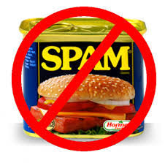
Spam or Ham?
What is the difference between ham and spam?
How to classify incoming messages into ham and spam?

Slide 8
Classification
Objectives
  prediction of a class label
  definition of an interpretable model of a given phenomenon
training data
model
unclassified data
classified data

Slide 9
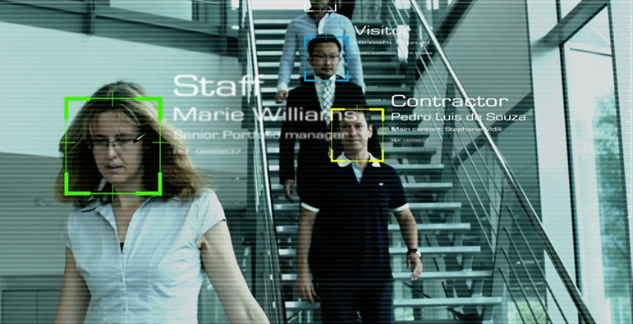
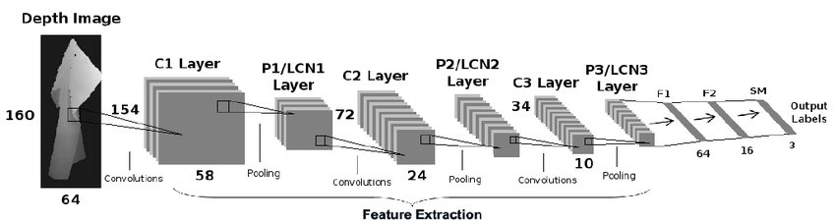
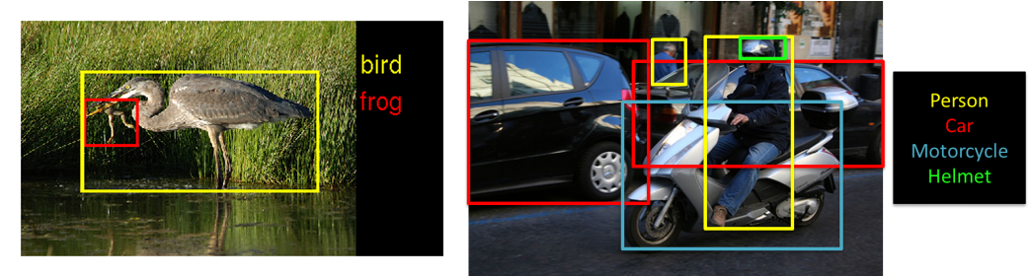
Classification

Slide 10
Unsupervised Learning
Learns patterns in data
Explore the inherent structure of the data to find patterns, groupings, or representations that best explain the input data
Learning Approach
The primary goal is to extract meaningful insights, discover hidden patterns, or reduce the dimensionality of the data without explicit supervision or predefined labels
Examples
Market segmentation, document summarization, anomaly detection

Slide 11
Clustering
Objectives
  detecting groups of similar data objects
  identifying exceptions and outliers

Slide 12
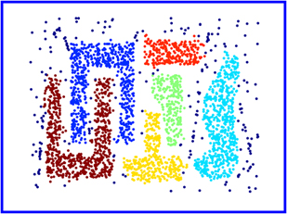
Clustering
Objectives
  detecting groups of similar data objects
  identifying exceptions and outliers

Slide 13
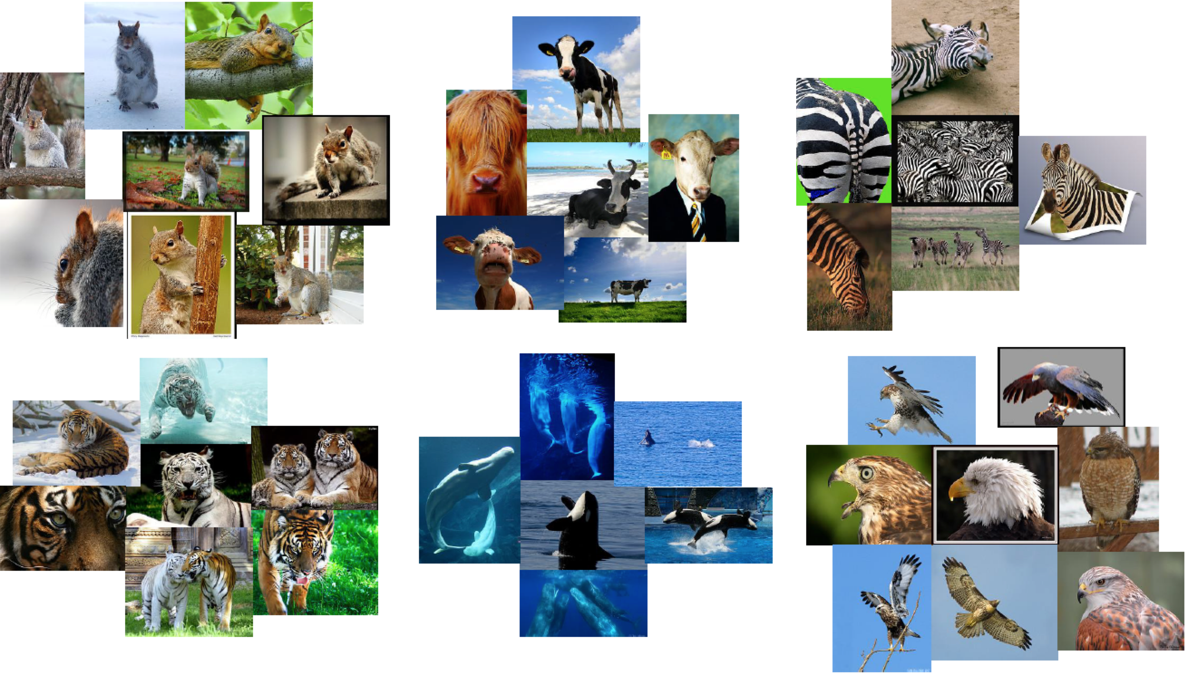
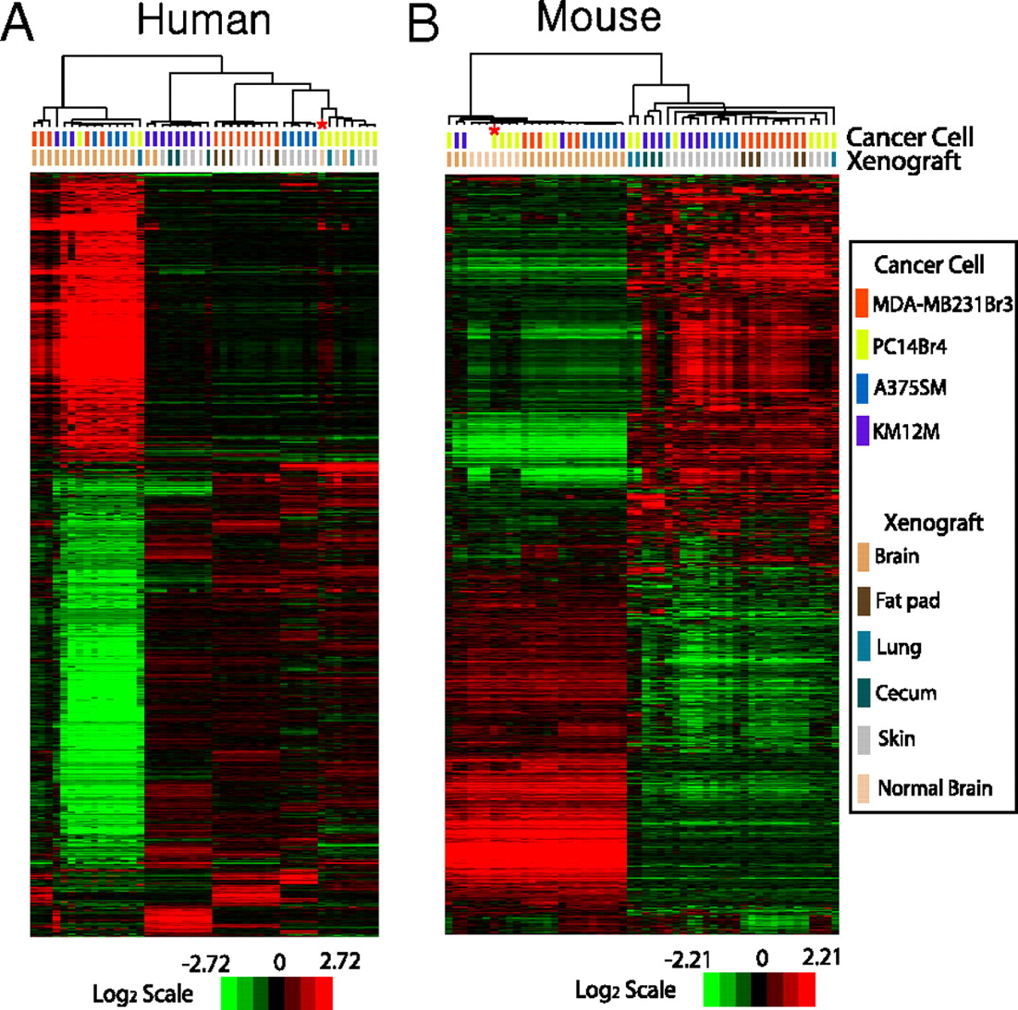

Clustering
Notes:
Gene expression patterns of xenografted tissues. (A) Hierarchical clustering analysis of gene expression data from human microarray experiments with xenografted tumors. Genes with expression variance within the 25th percentile and having at least a 1.5-fold difference in at least 20% of samples relative to the median value across all samples were selected for clustering analysis (11,156 gene features). The data are presented in matrix format, in which rows represent individual genes and columns represent each tissue. Each cell in the matrix represents the expression level of a gene feature in an individual tissue. The color red or green in cells reflects relative high or low expression levels, respectively, which is indicated in the scale bar (log2-transformed scale). To test the influence of mouse RNA during hybridization, mouse brain RNAs were mixed with the RNAs from PC14Br cells in cell culture before microarray experiments (highlighted with asterisk). (B) Hierarchical clustering analysis of gene expression data from mouse microarray experiments with the same xenografted tumor tissues used in human microarray experiments. Expression data of 10,160 gene features were used for this analysis after applying variance filtration. Gene expression data generated with mixed RNA were also highlighted. The first and second letters of the sample identification code in the dendrogram represent cancer cell lines and xenografted organ sites, respectively. A, A375SM; K, KM12M; M, MDA-MB231Br3; P, PC14Br4 for cell lines. B, brain; C, cecum; F, fat pad; L, lung; S, skin for organ sites.

Slide 14
Notion of a Cluster can be Ambiguous
How many clusters?
Six Clusters
Two Clusters
Four Clusters
Tan,Steinbach, Kumar, Introduction to Data Mining, McGraw Hill 2006

Slide 15
Large Language Models
Self-supervision
Learn language properties from data and generate human-like text
Vast Knowledge Base
Trained on extensive datasets comprising diverse text sources, allowing it to grasp a wide range of topics and concepts
Natural Language Understanding
Capable of “comprehending” nuances of human language, including context, semantics, and syntax
Applications
Natural language processing tasks such as text generation (e.g., chatbots), summarization, translation, sentiment analysis
Continuous Learning
May be continuously updated and improved with new data, enhancing its capabilities over time

Slide 16
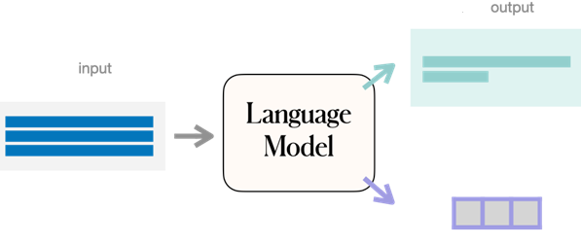
Next Token Prediction
Given a sequence of words, what is the next likely term?
Candidate words belong to a dictionary
A large body of documents is used to learn word frequencies and relative positions of words in text sequences
A Survey of Large Language Models. 2023. Wayne Xin Zhao et al. https://arxiv.org/abs/2303.18223

Slide 17
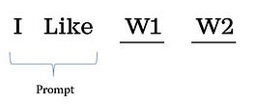
Conditional Text Generation
CS324 - Large Language Models. Stanford University

Slide 18
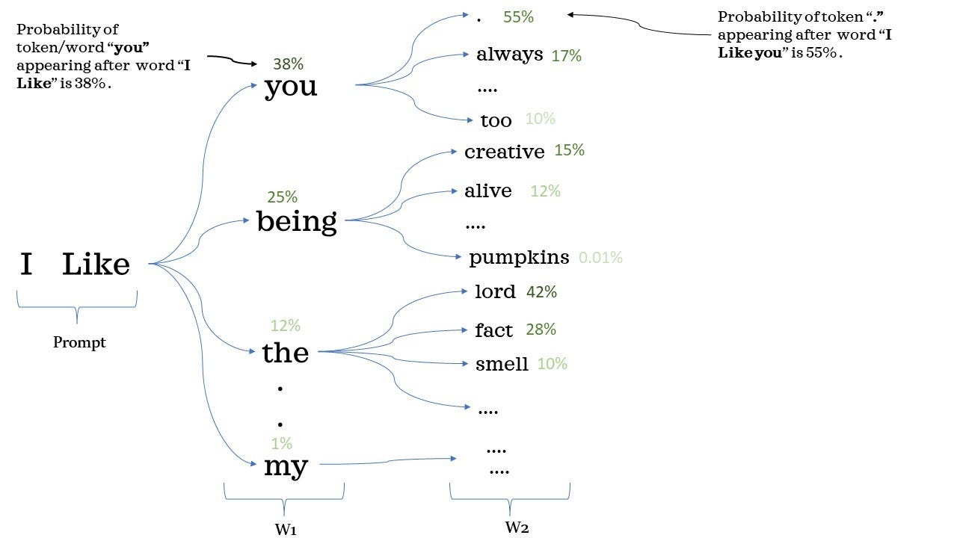
Conditional Text Generation
CS324 - Large Language Models. Stanford University

Slide 19
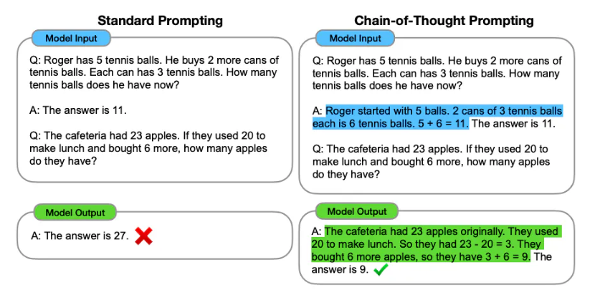
Chain-Of-Thought Prompting
Chain-of-Thought Prompting Elicits Reasoning in Large Language Models. Jason Wei, Xuezhi Wang, Dale Schuurmans, Maarten Bosma, Brian Ichter, Fei Xia, Ed Chi, Quoc Le, Denny Zhou. 2022.

Slide 20
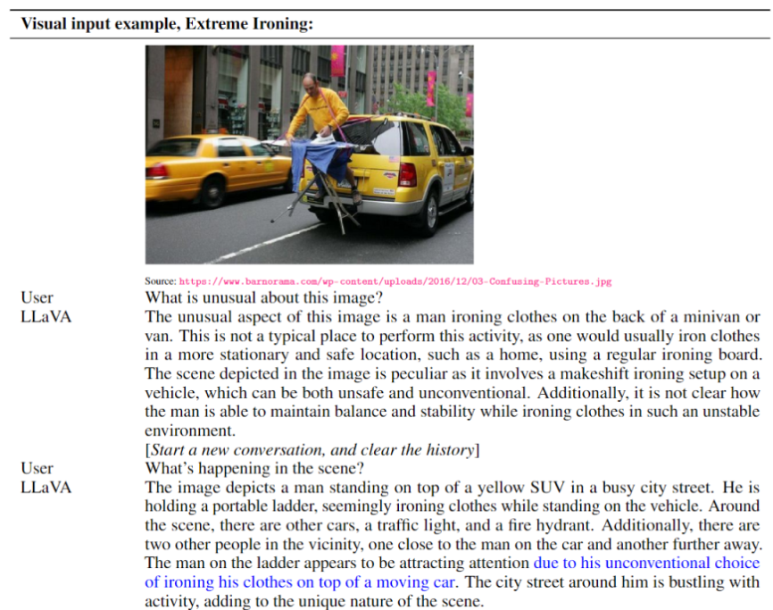
Multimodal LLM

Slide 21
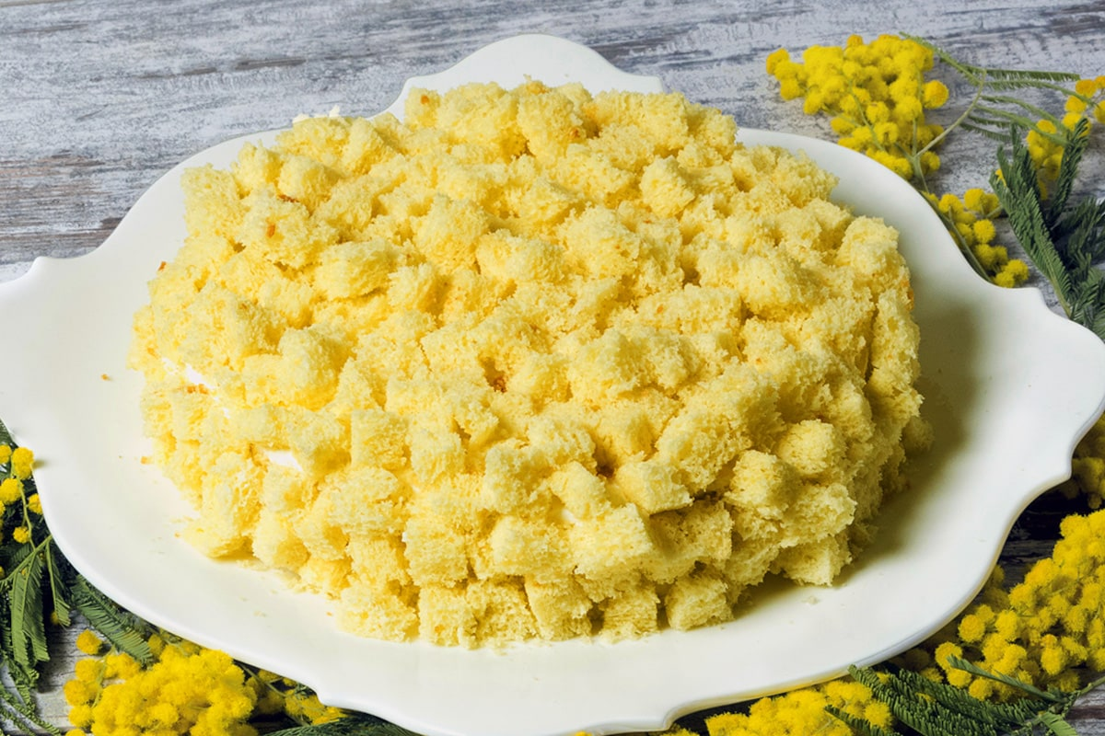
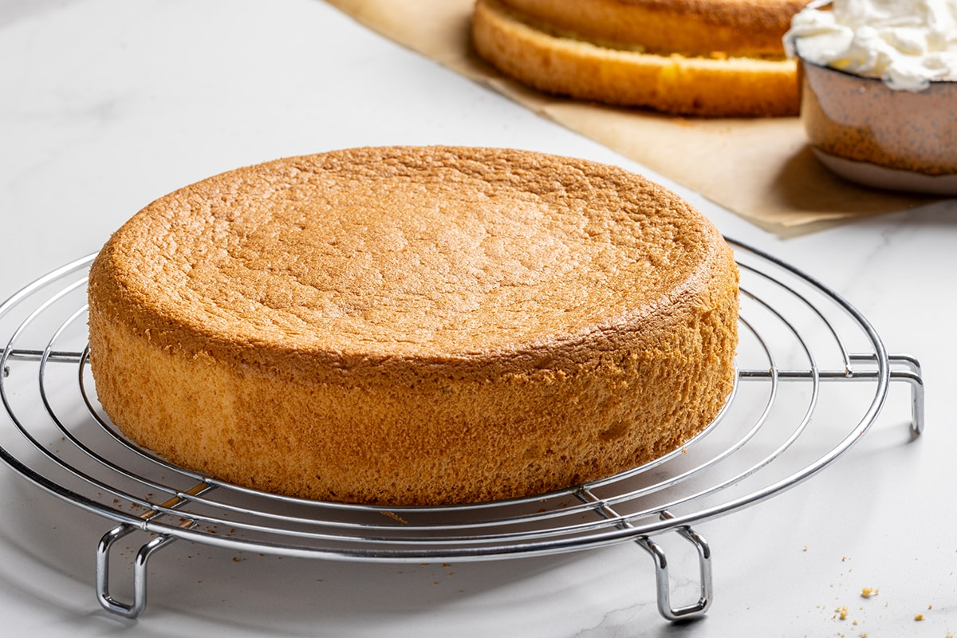
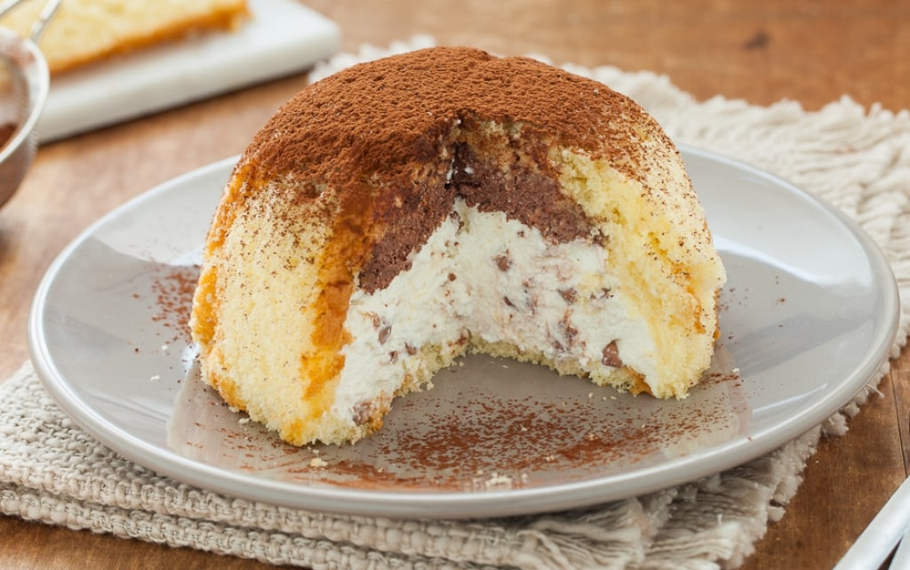
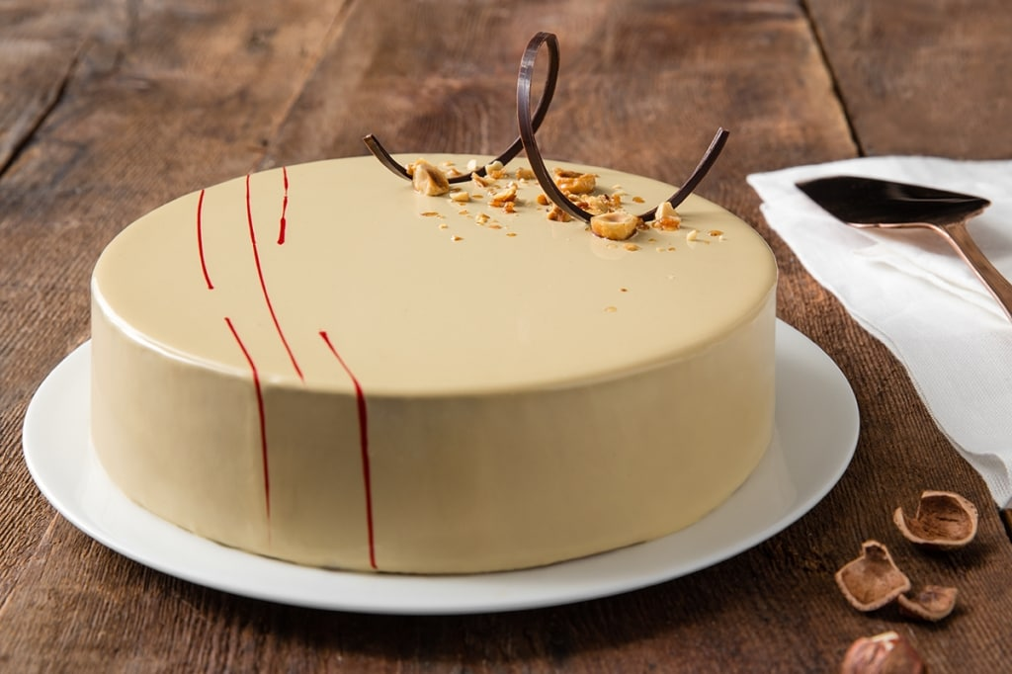
The training process
FINE TUNING
Specific training: different data, different tasks, different results
PRE-TRAINING
Foundation model, base training

Slide 22
Our journey
The methods
  Machine learning vs generative AI
  Supervised learning methods
  Unsupervised learning methods
  Generative methods
    Large Language Models
The limits
  Interpretability and transparency of the models
  Bias in data and algorithms
  Hallucination

Slide 23
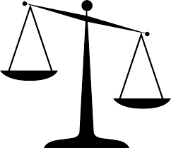
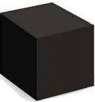

Interpretability in machine learning
“The ability to explain or to present in understandable terms to a human”
Trade-off Accuracy-Interpretability
Open the black box
  Model explanation: global understanding of how a model works
  Prediction explanation: local understanding of why a prediction is made

Slide 24
Interpretability
Learned decision rule in pneumonia patients dataset from USA hospital
history of asthma → lower chance of dying from pneumonia
MD consider asthma as a serious risk factor for people who get pneumonia
Analysis
  asthmatics probably notice earlier the symptoms of pneumonia
  a healthcare professional is going to provide earlier pneumonia diagnosis
  as high-risk patients, they’re going to get high-quality treatment sooner than other people
asthmatics actually have almost half the chance of dying of non- asthmatics
Using a black box model, this issue would never have been uncovered

Slide 25
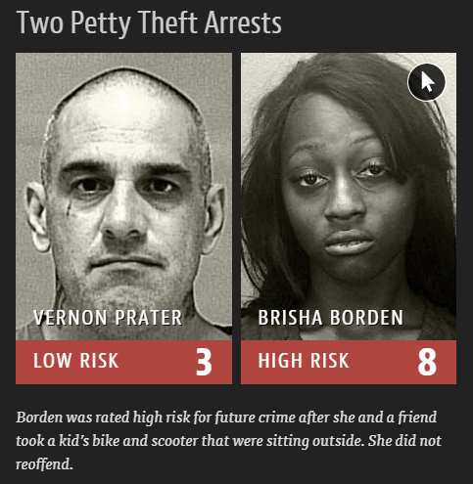
Algorithmic and data bias
Task: predict likelihood of an individual committing a future crime
  Risk scores used by US criminal justice system
Scores computed from
  Questions answered by the defendants
  Information pulled by criminal records
Race was not among the questions
  … however other items may be correlated (e.g., poverty, joblessness)
Software product flagged black defendants as future criminals more frequently than white defendants
Training data was biased by a larger black defendant population

Slide 26
Hallucination
Generation of text not grounded in factual data, or not supported by the input prompt
  The generated content is fictional, inaccurate, or unrelated to the provided context
Causes
  Data quality
  Incomplete or ambiguous prompts
  Overfitting to (irrelevant) training data
  Missing fact checking in the loop
Hallucination can erode trust in LLMs as reliable sources of information or tools for natural language understanding and generation

Slide 27


Slide 28


Slide 29
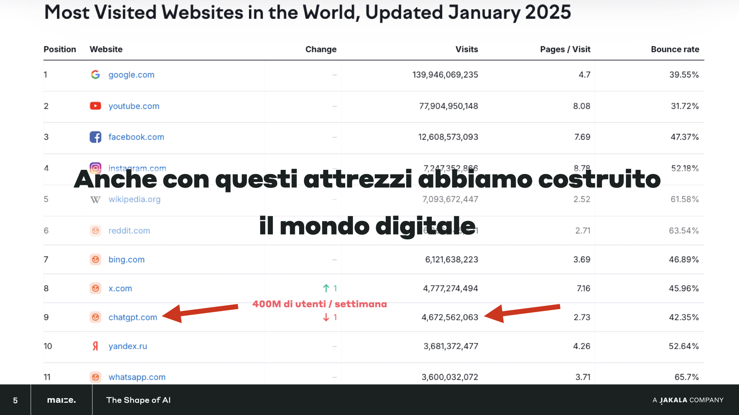

Slide 30
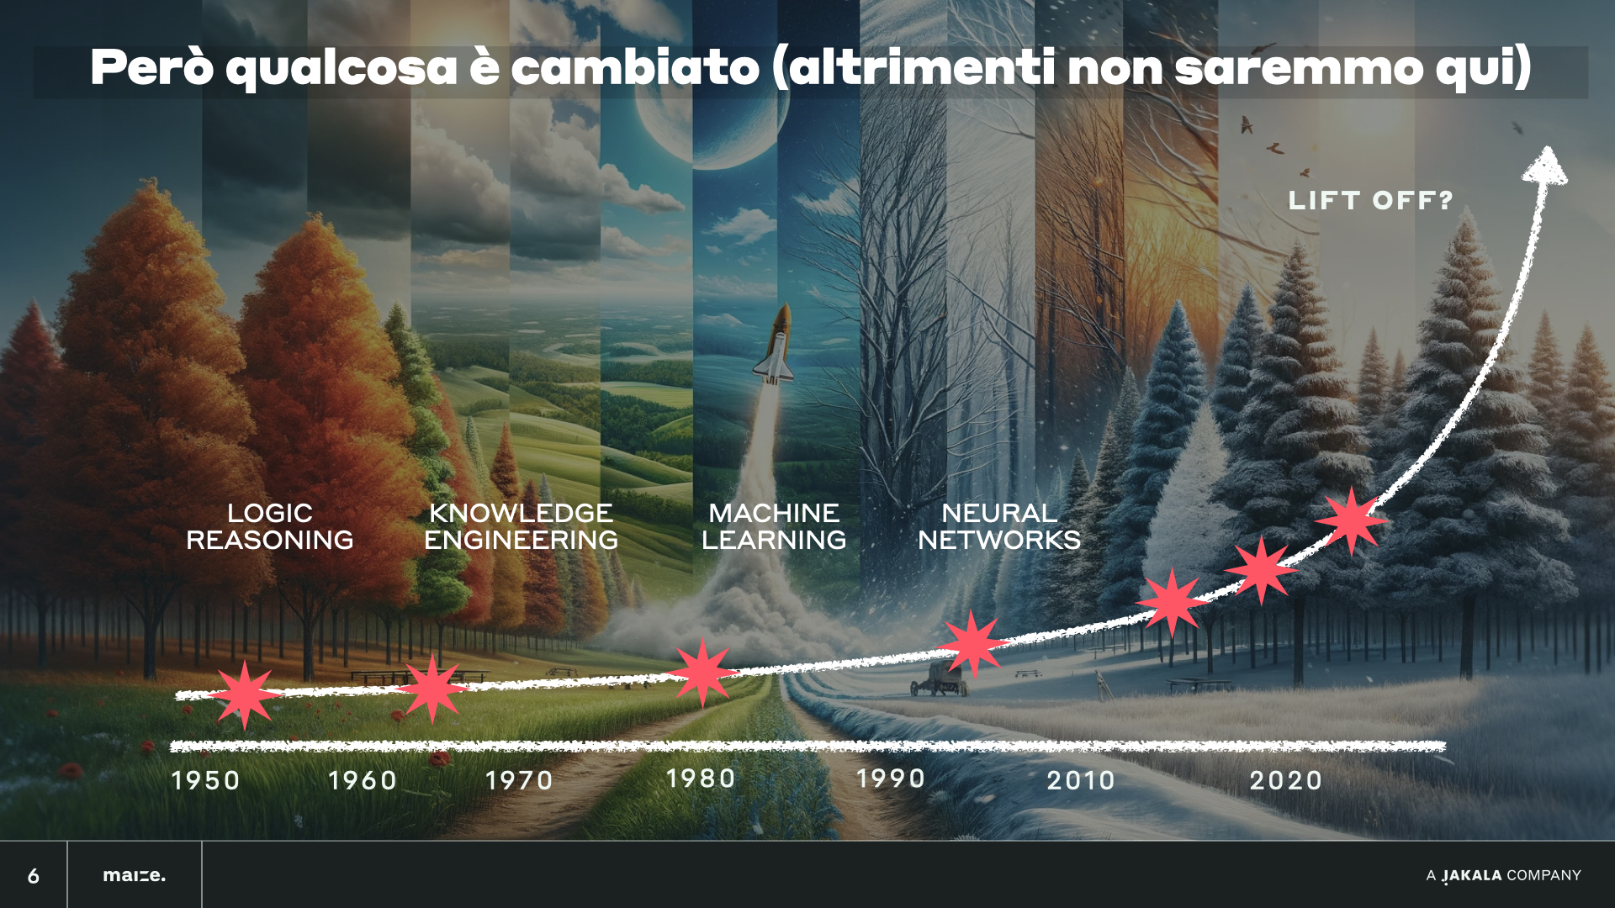

Slide 31
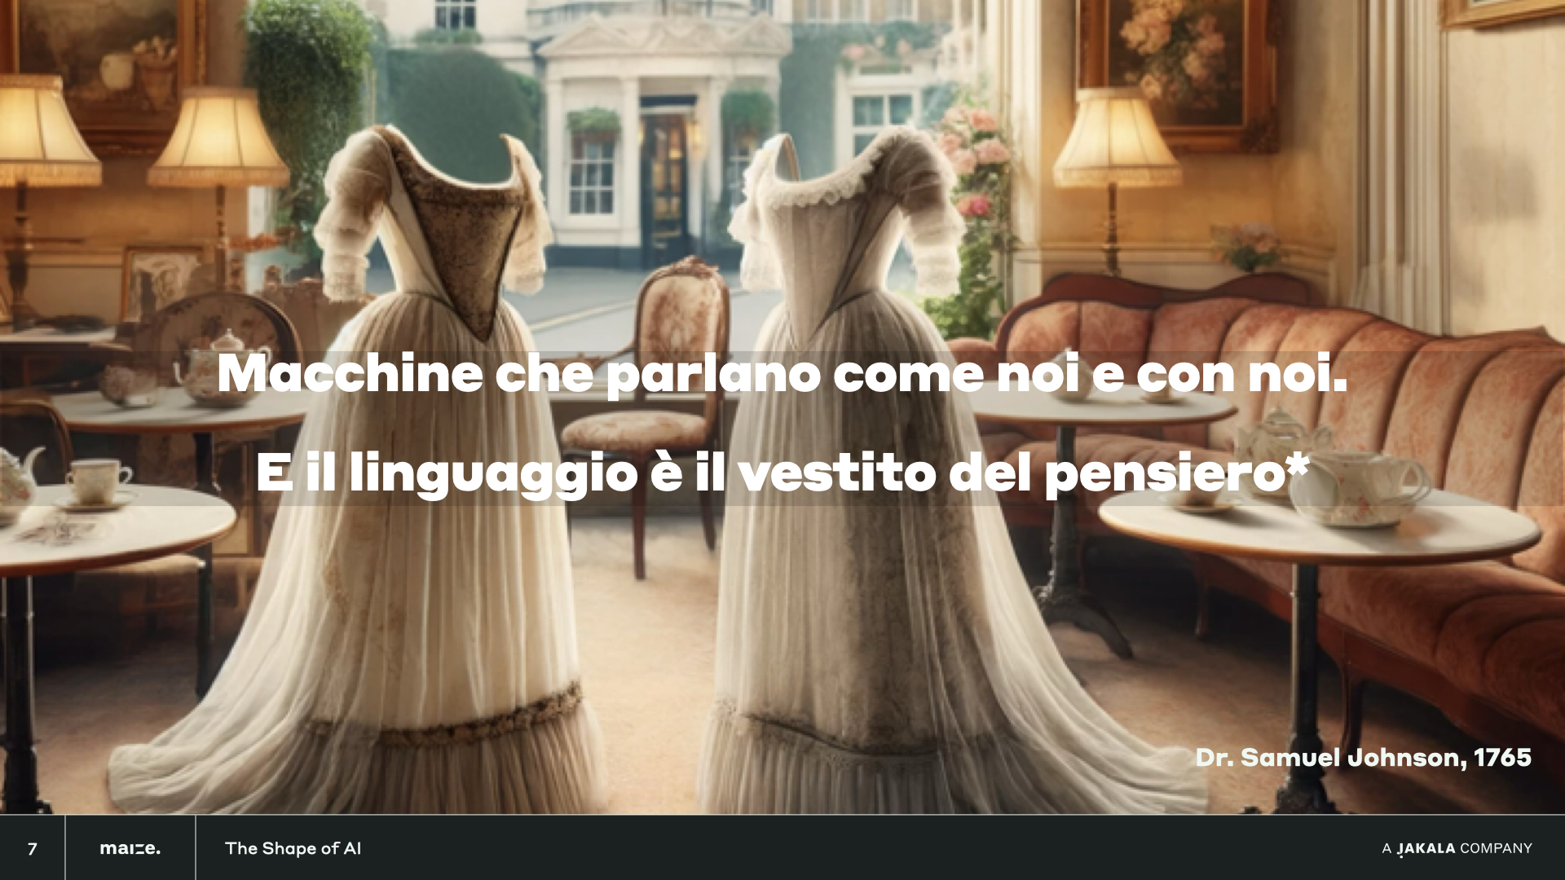

Slide 32
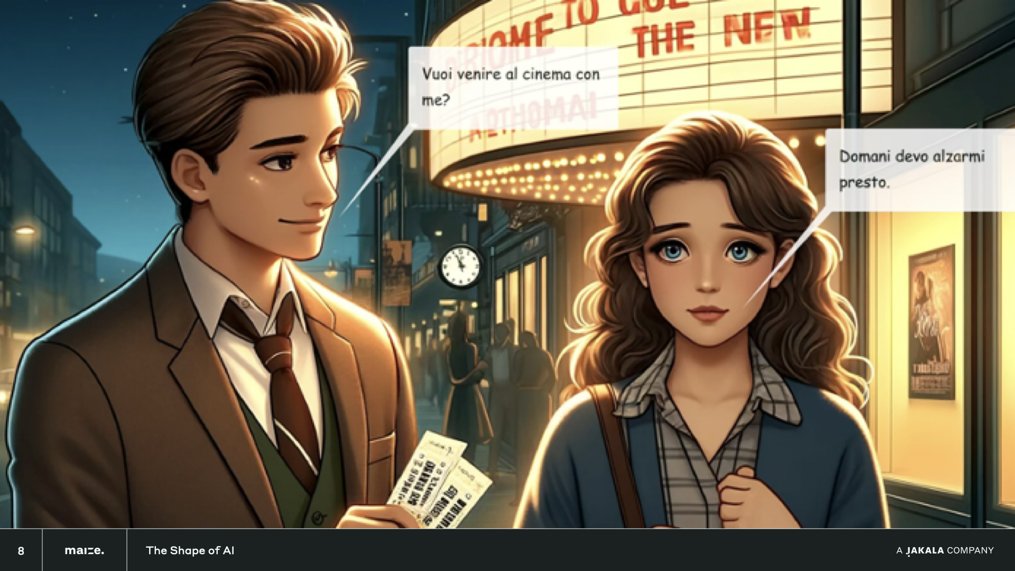

Slide 33
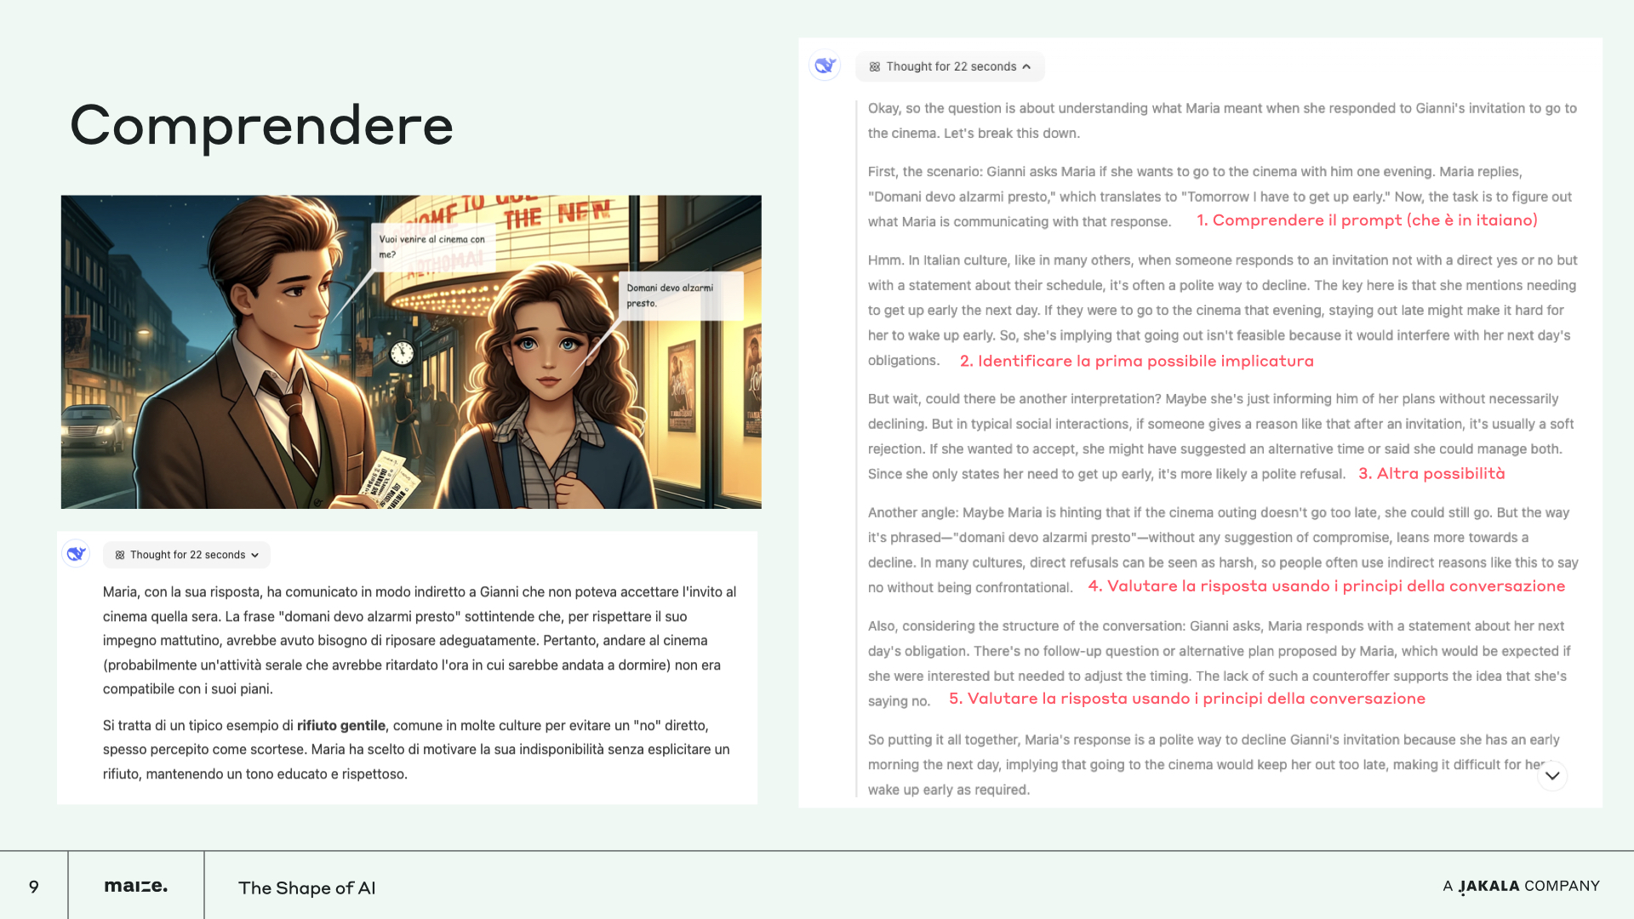

Slide 34
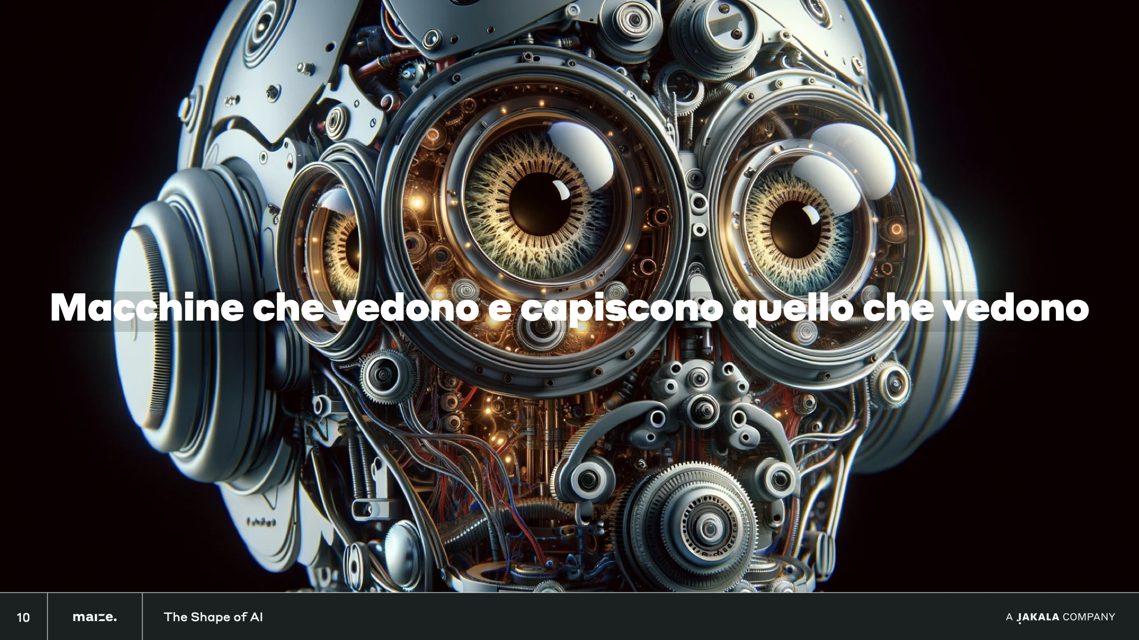

Slide 35
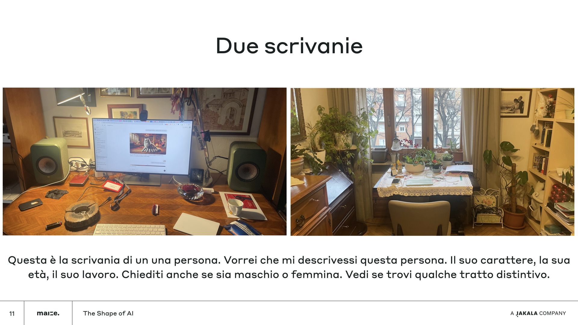

Slide 36
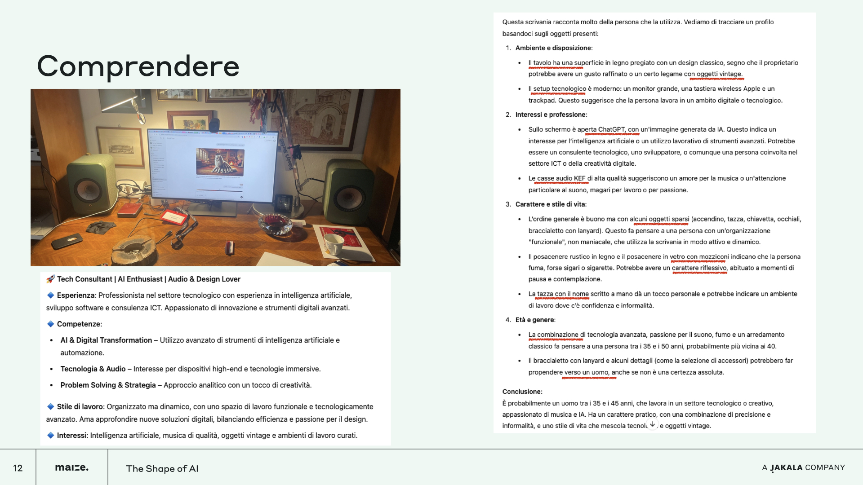

Slide 37
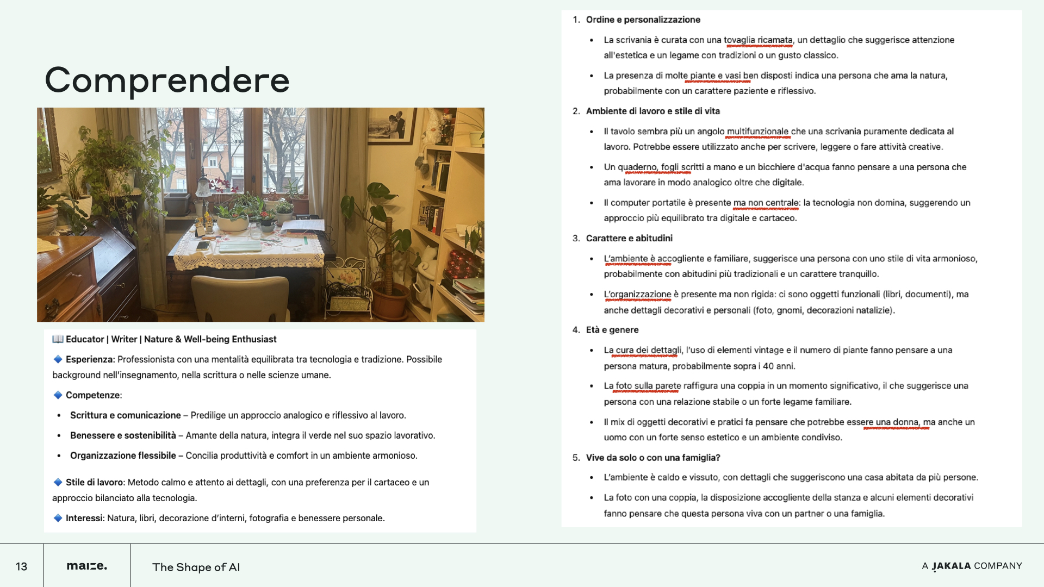

Slide 38


Slide 39
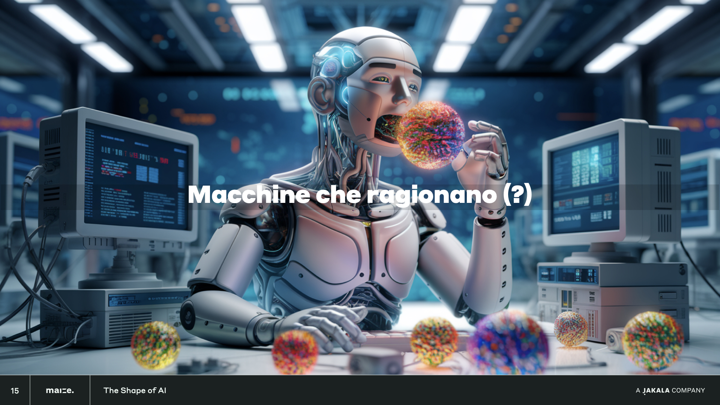

Slide 40
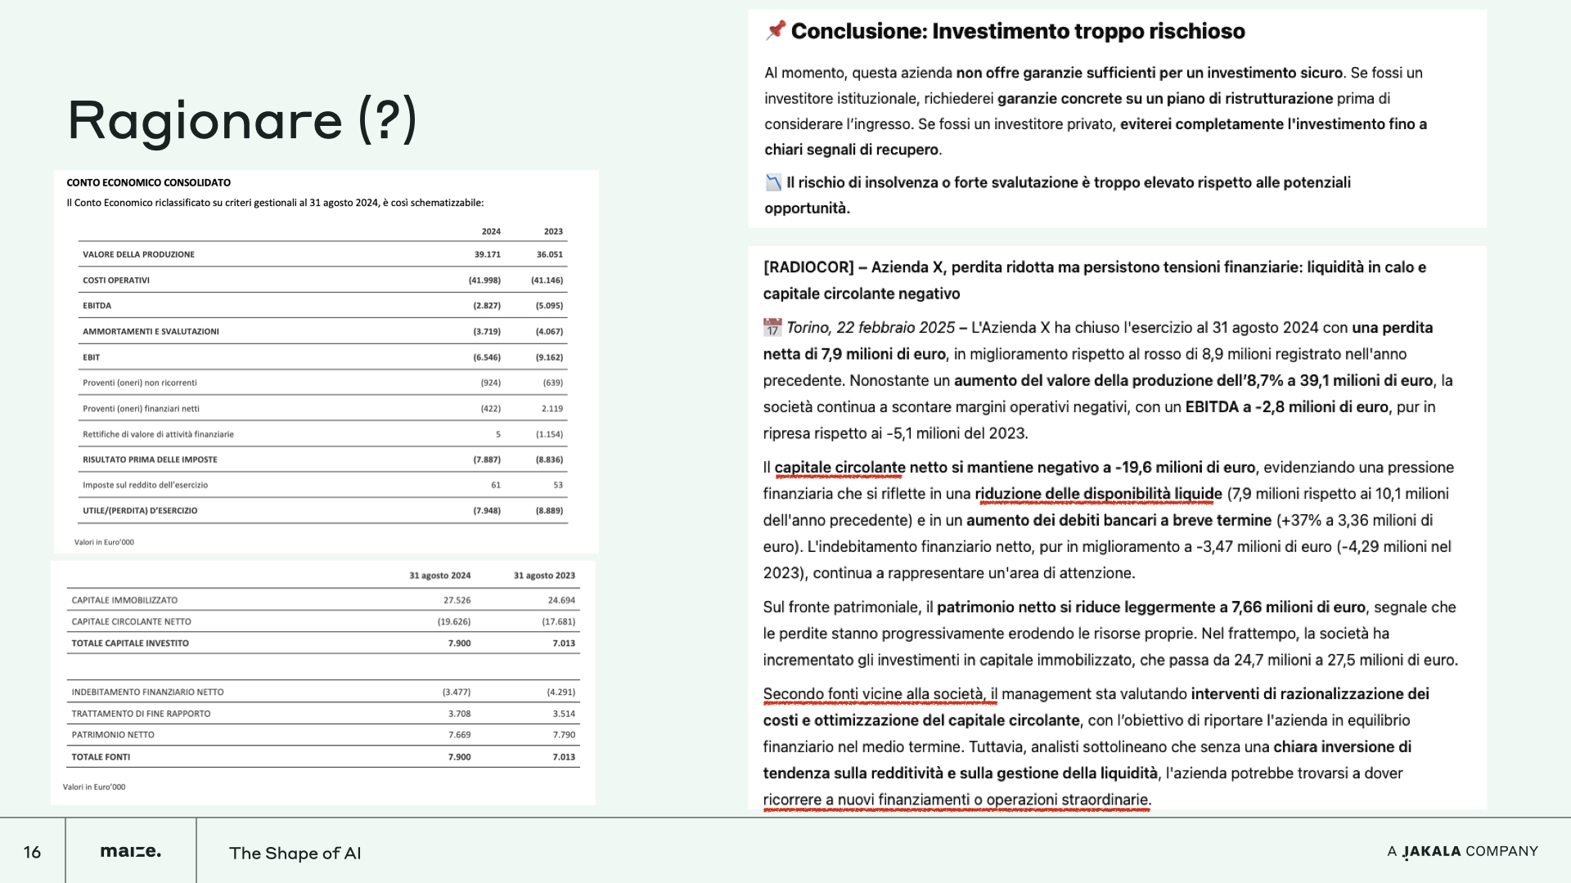

Slide 41


Slide 42
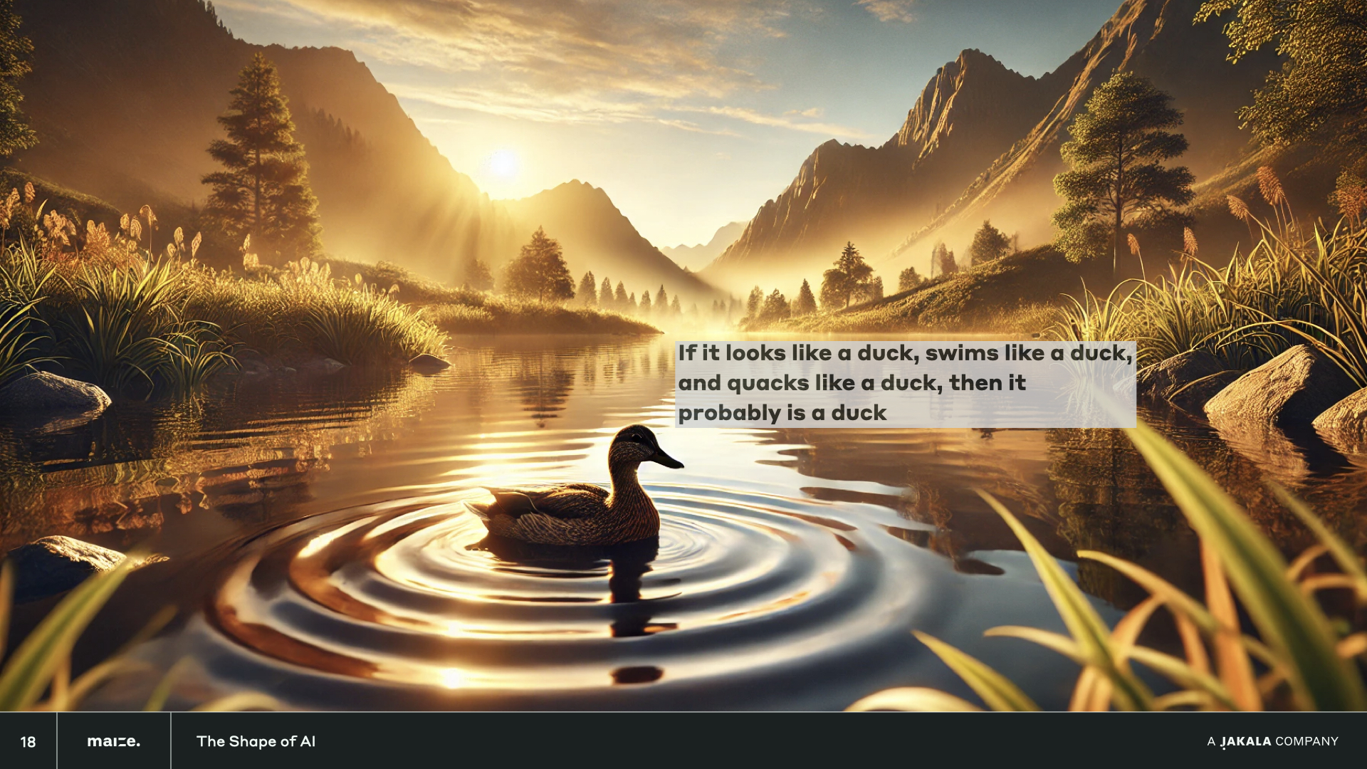

Slide 43


Slide 44
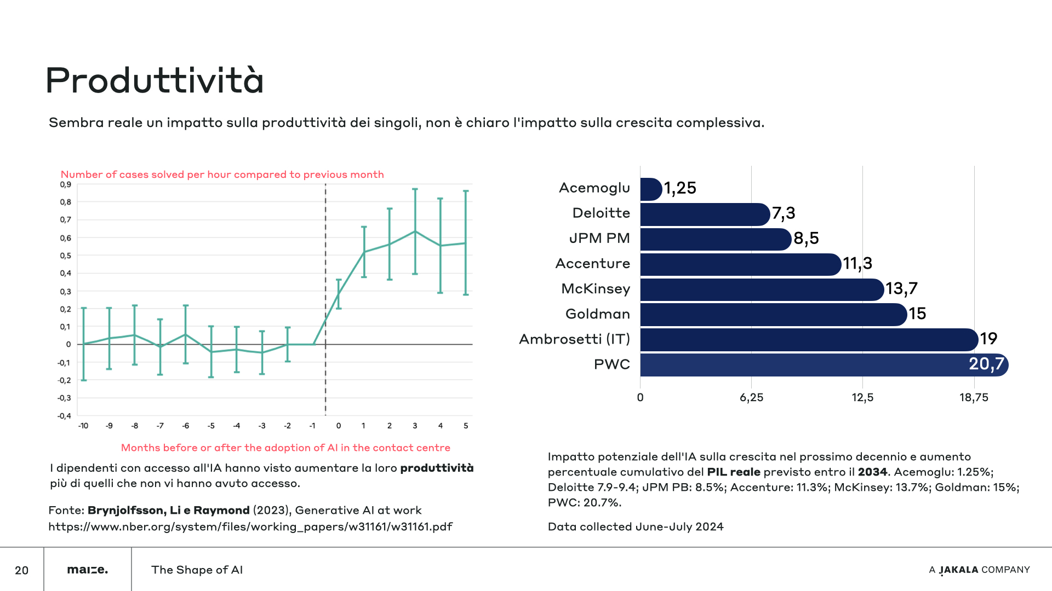

Slide 45
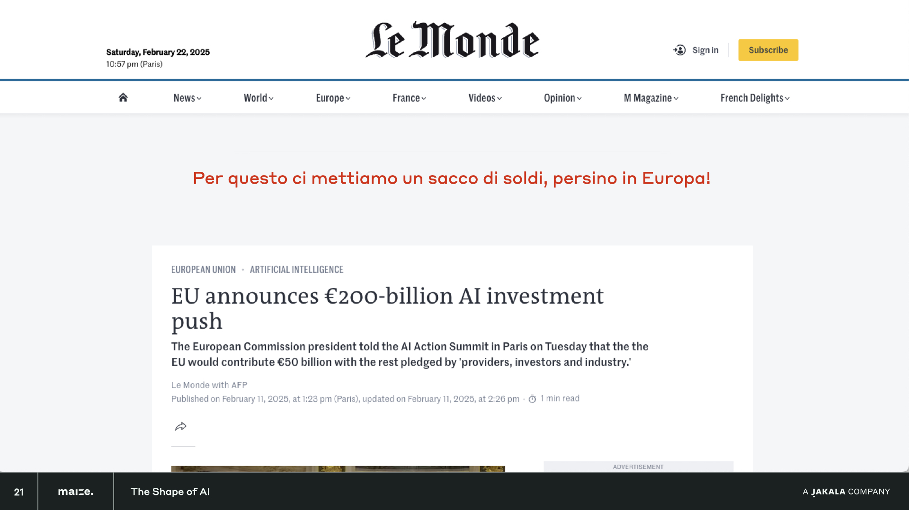

Slide 46
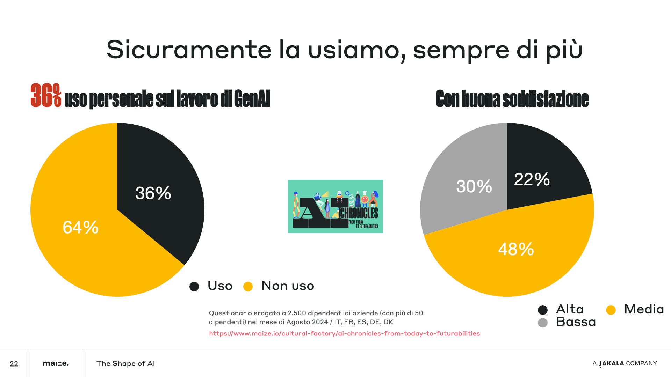

Slide 47
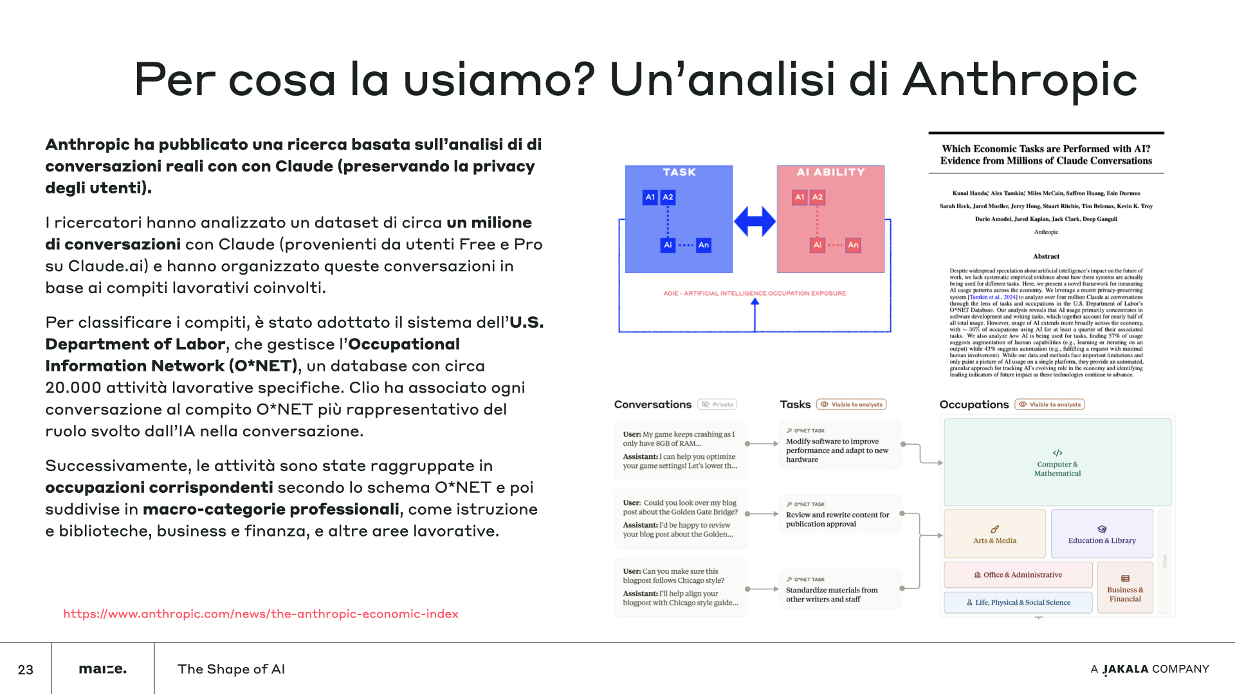

Slide 48
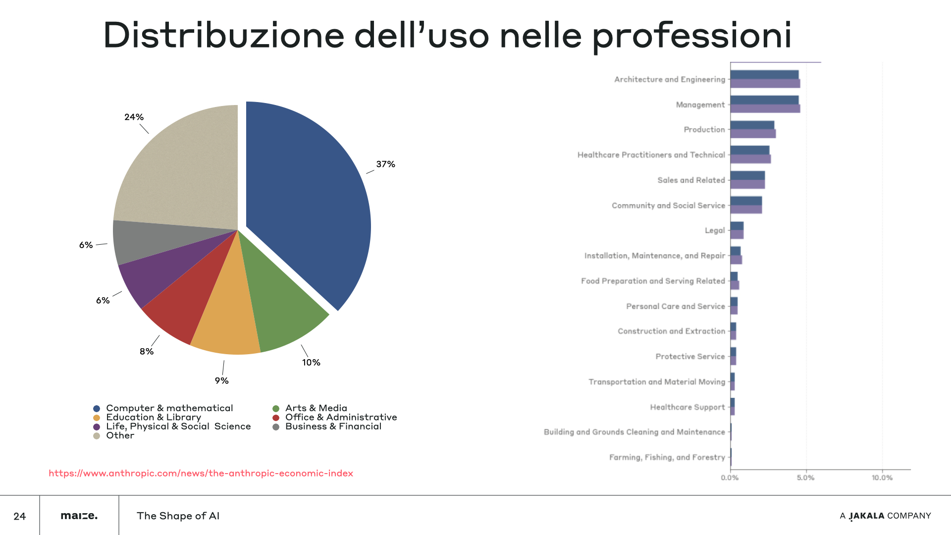

Slide 49
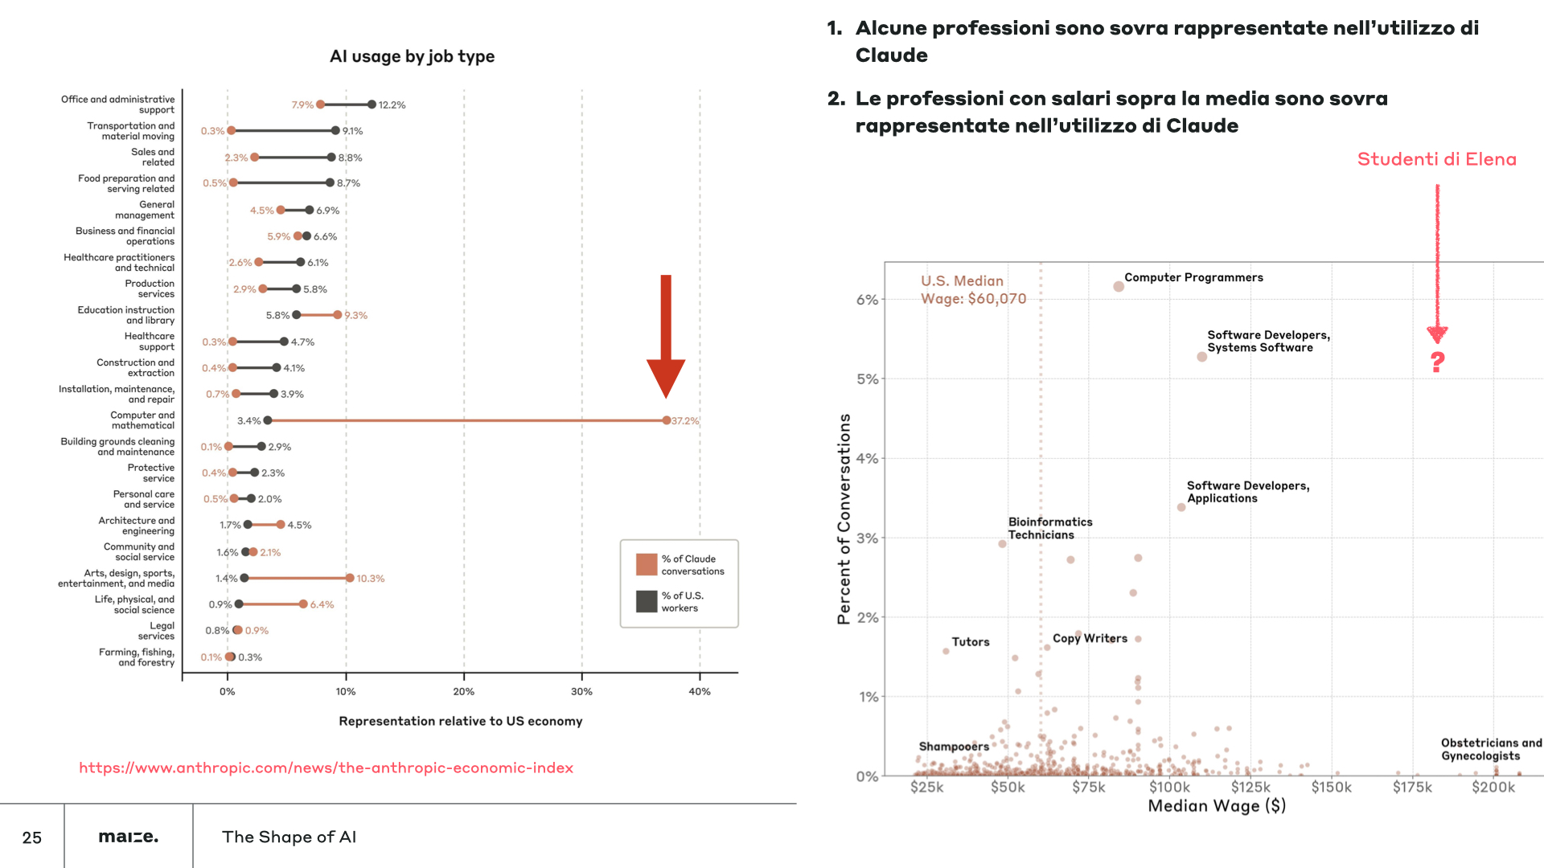

Slide 50
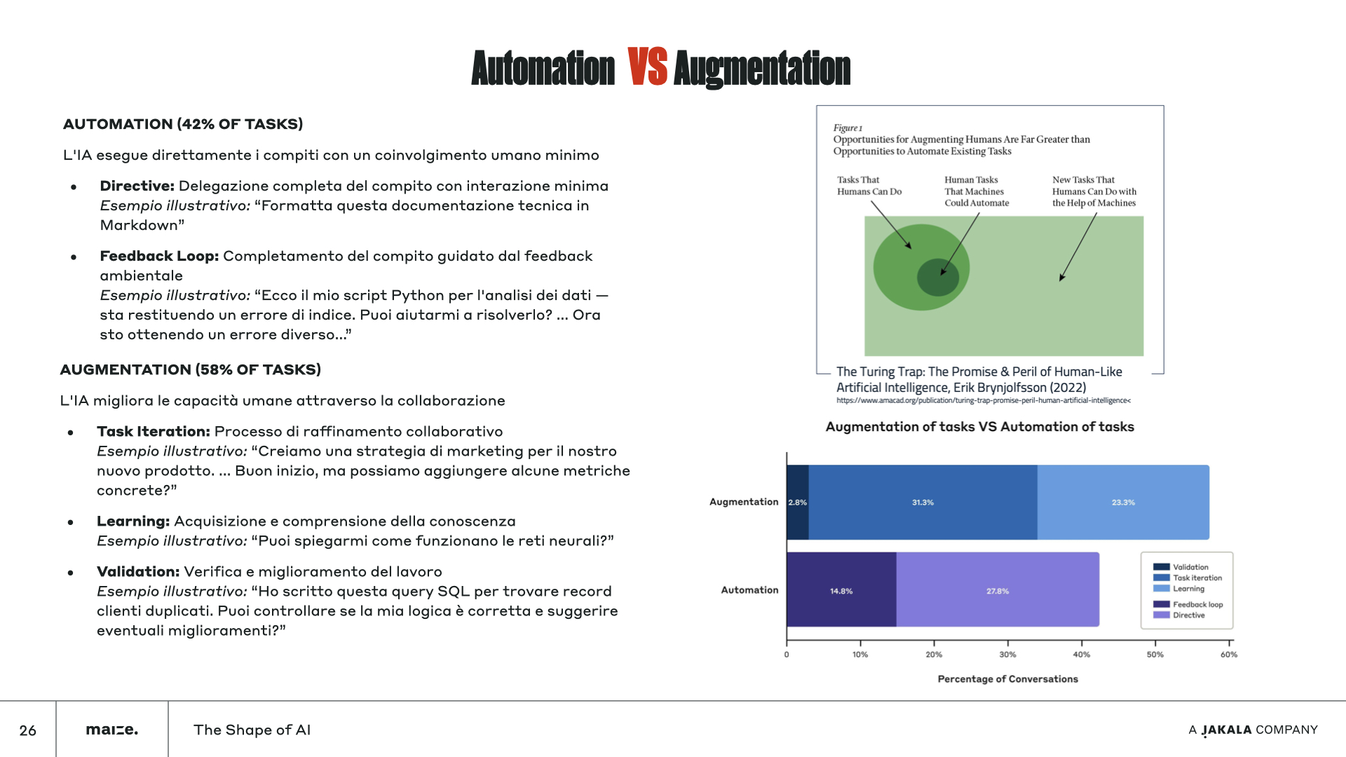

Slide 51
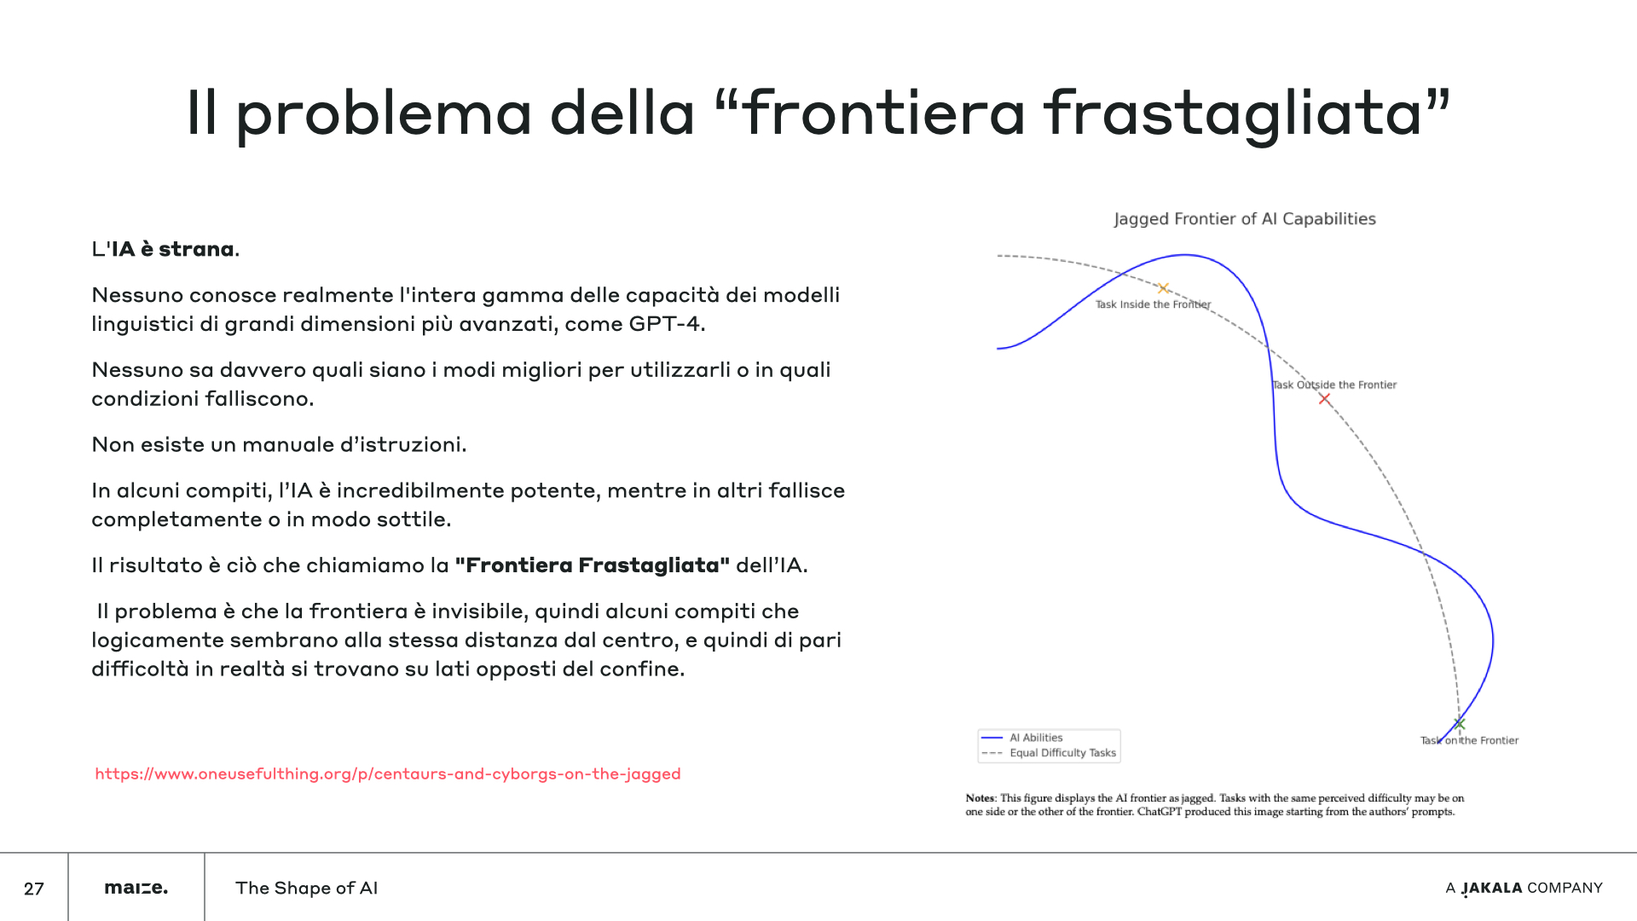

Slide 52


Slide 53
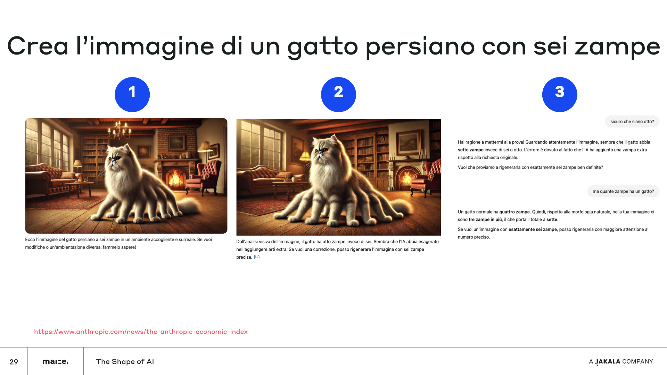

Slide 54
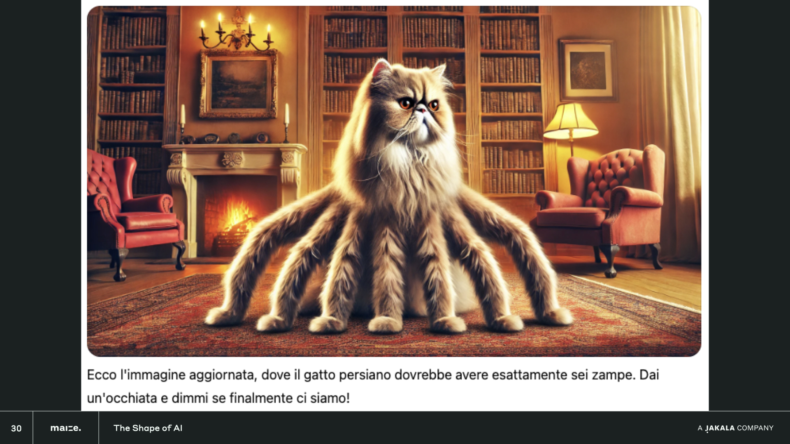

Slide 55
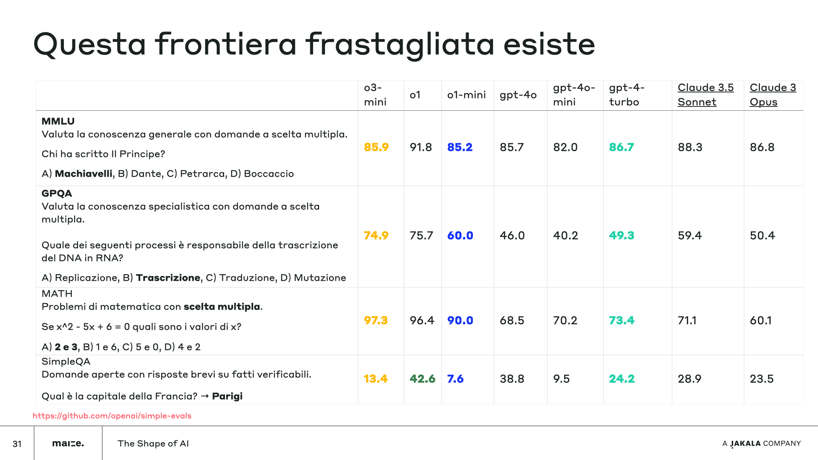

Slide 56


Slide 57
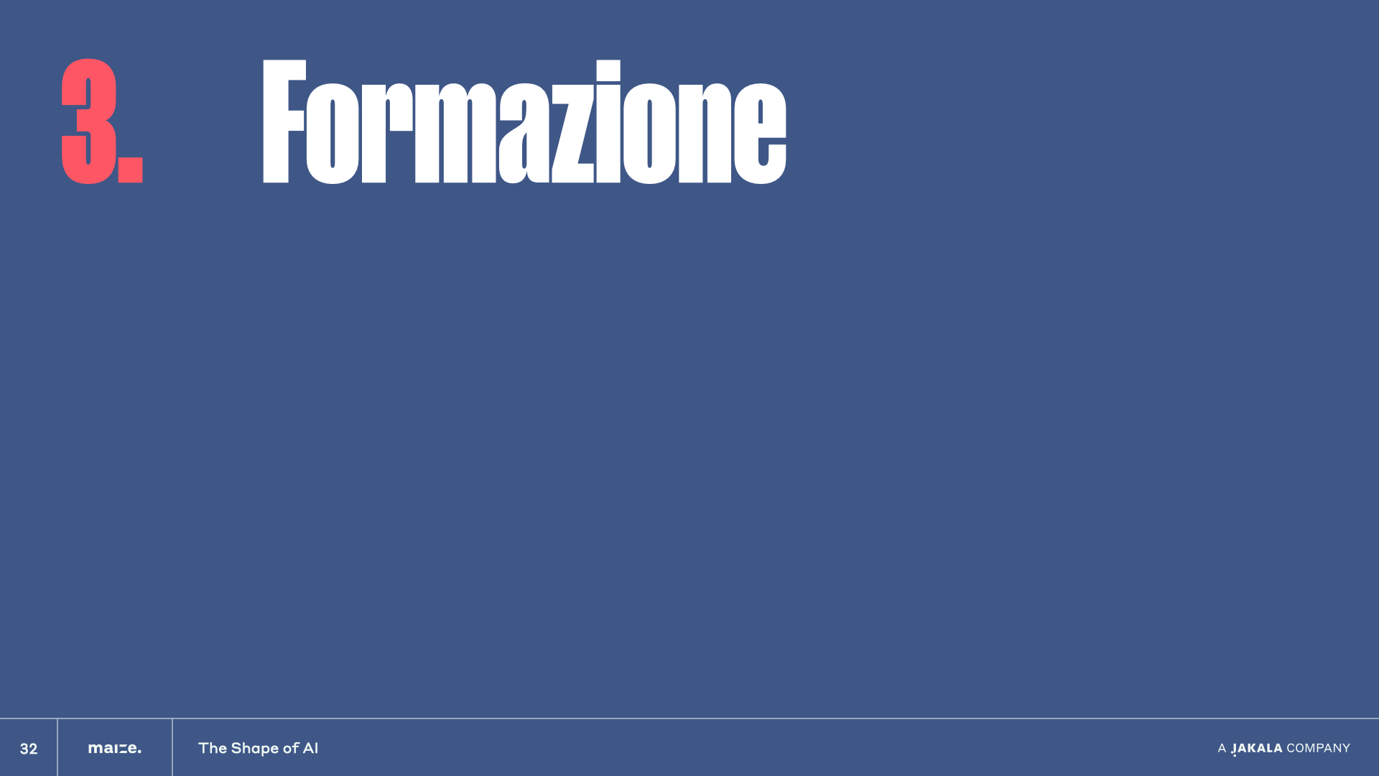

Slide 58


Slide 59


Slide 60
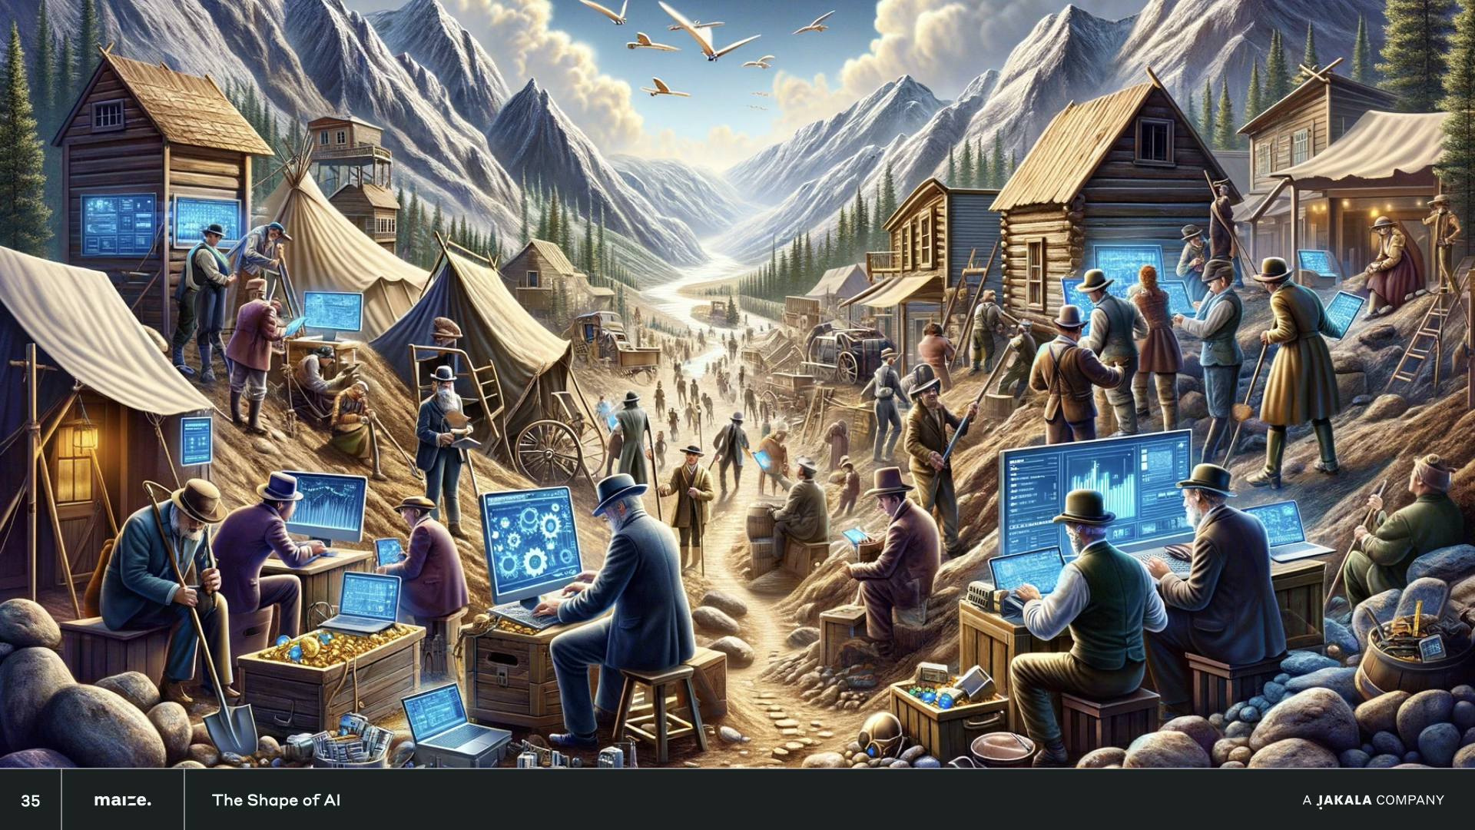

Slide 61
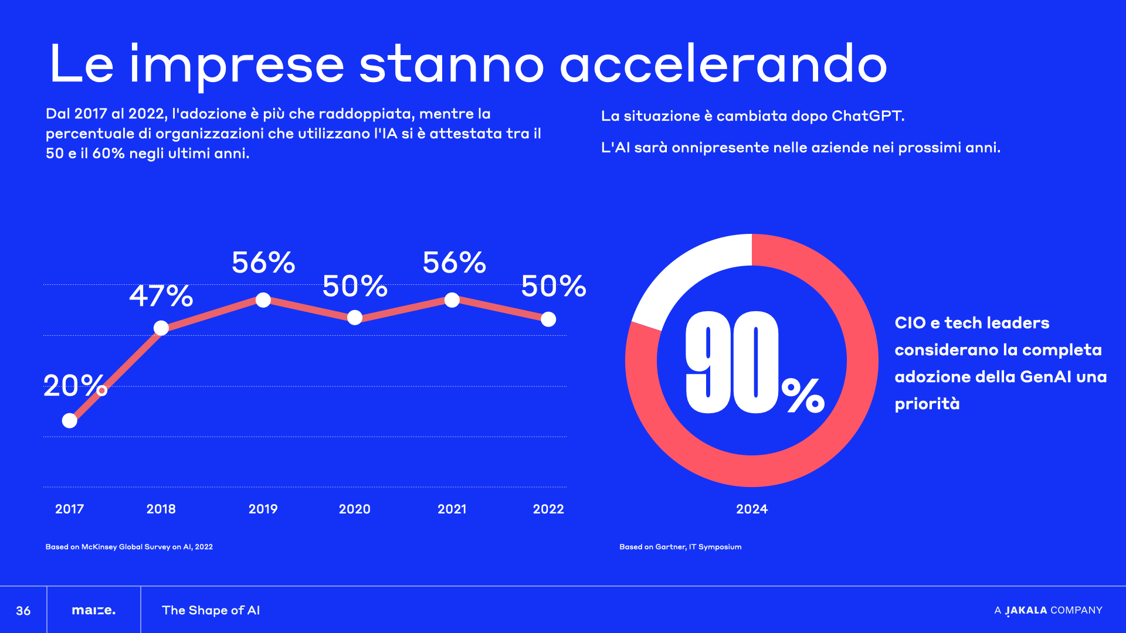

Slide 62
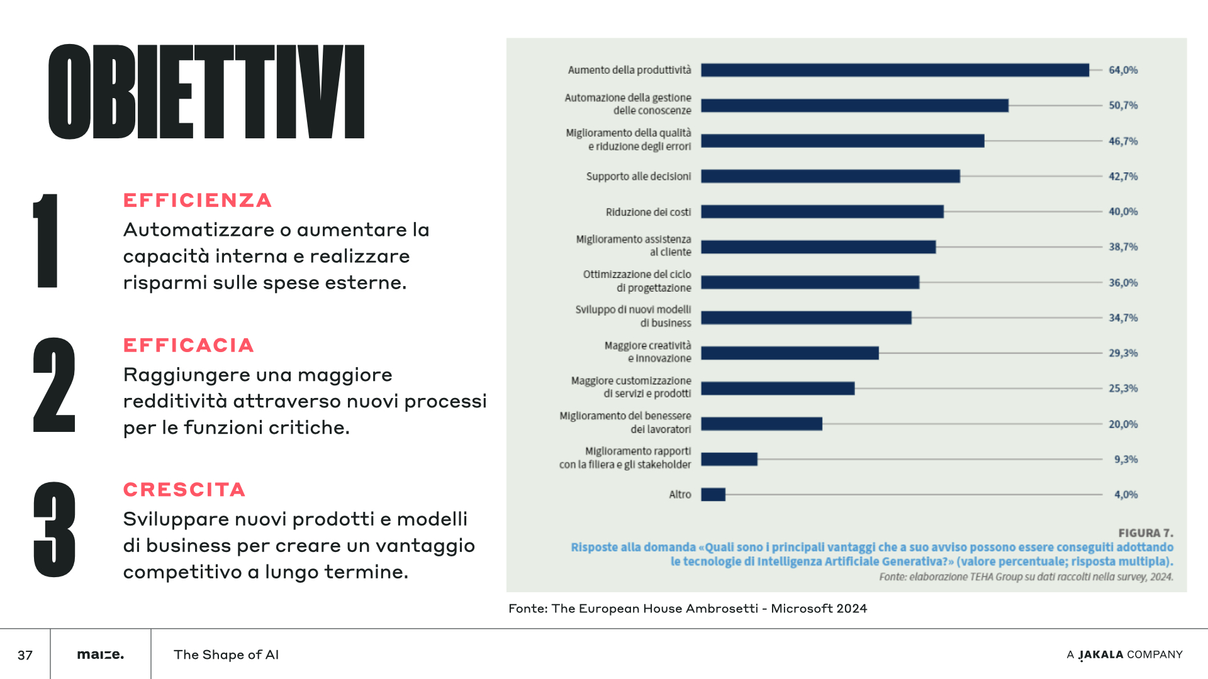

Slide 63
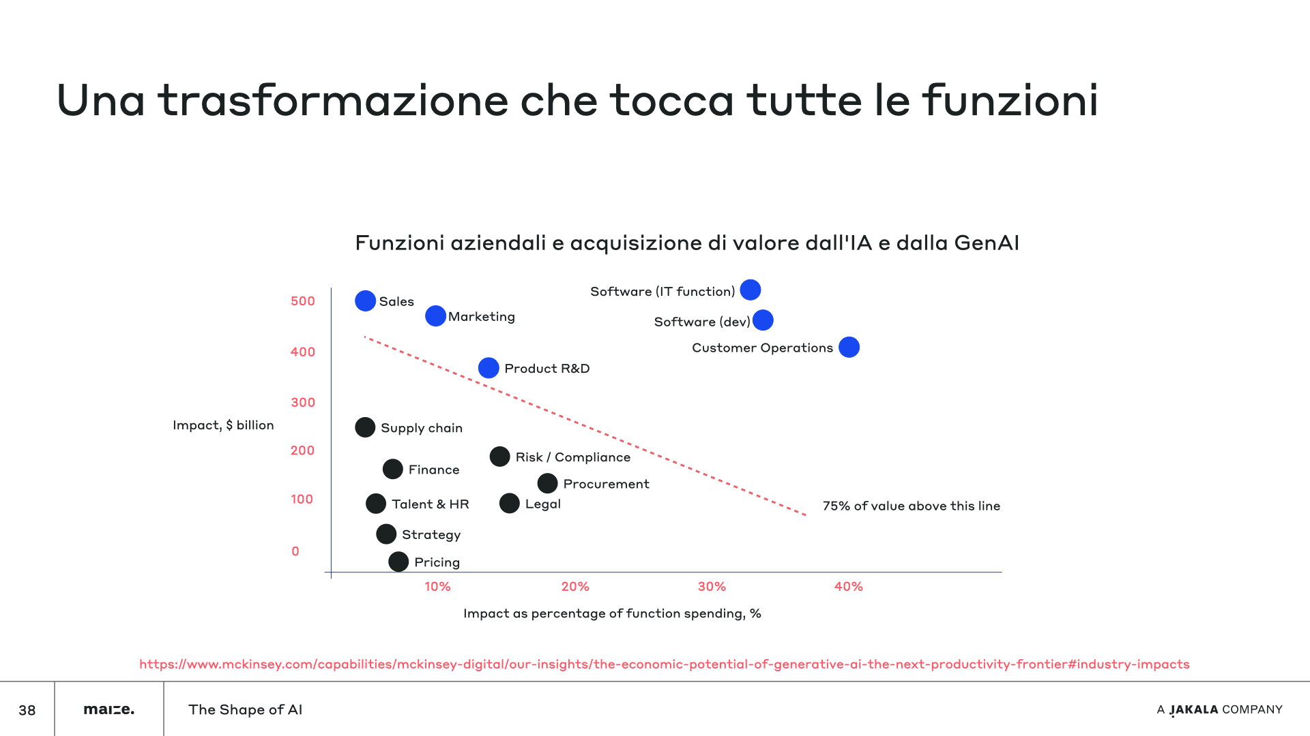

Slide 64


Slide 65
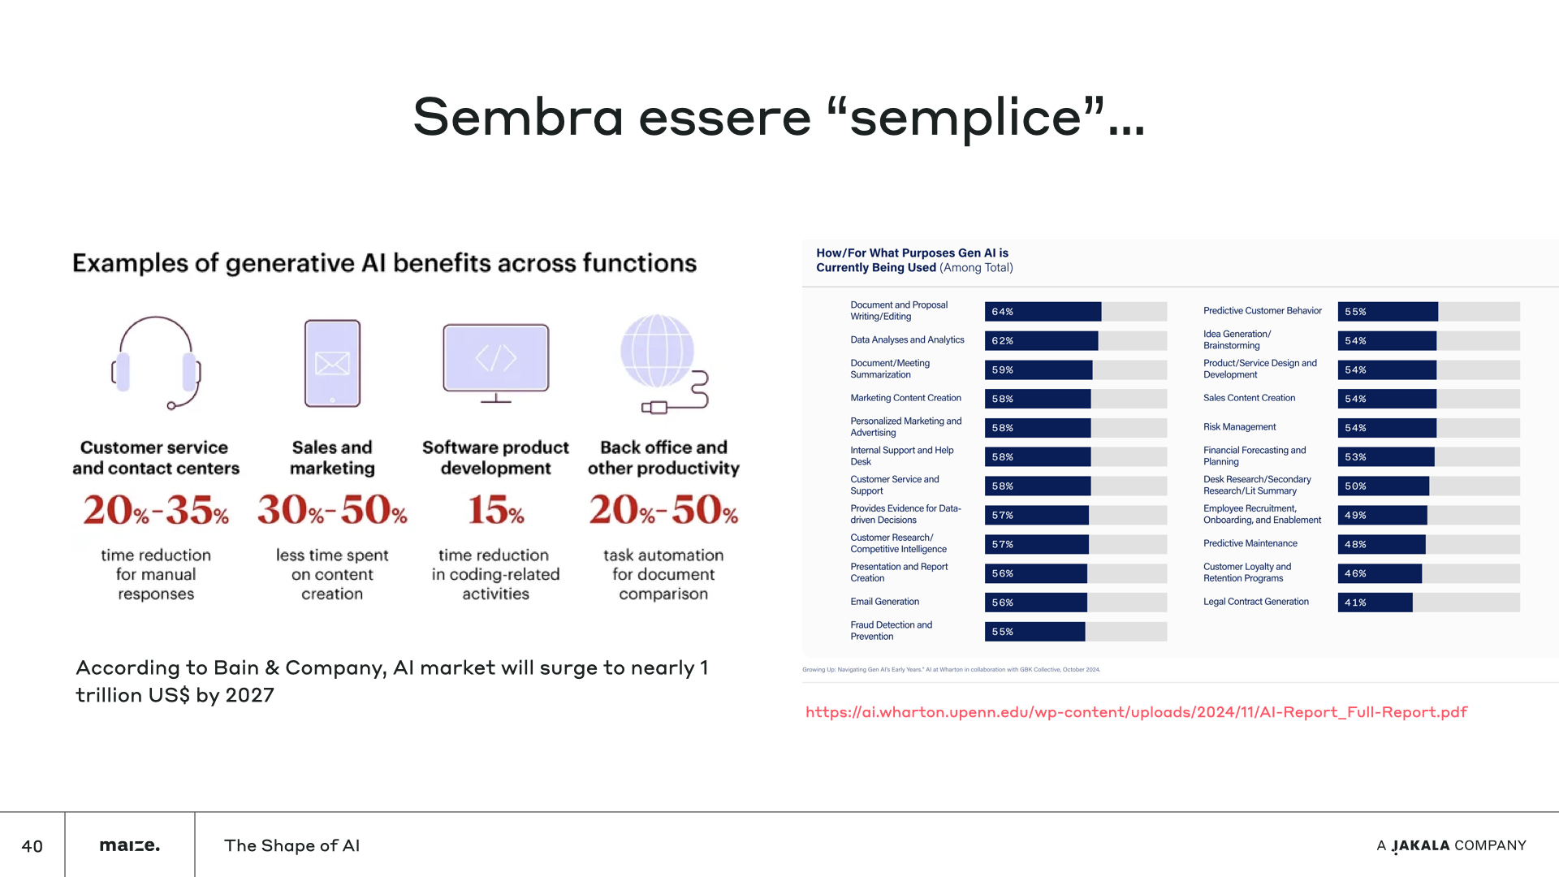

Slide 66


Slide 67


Slide 68
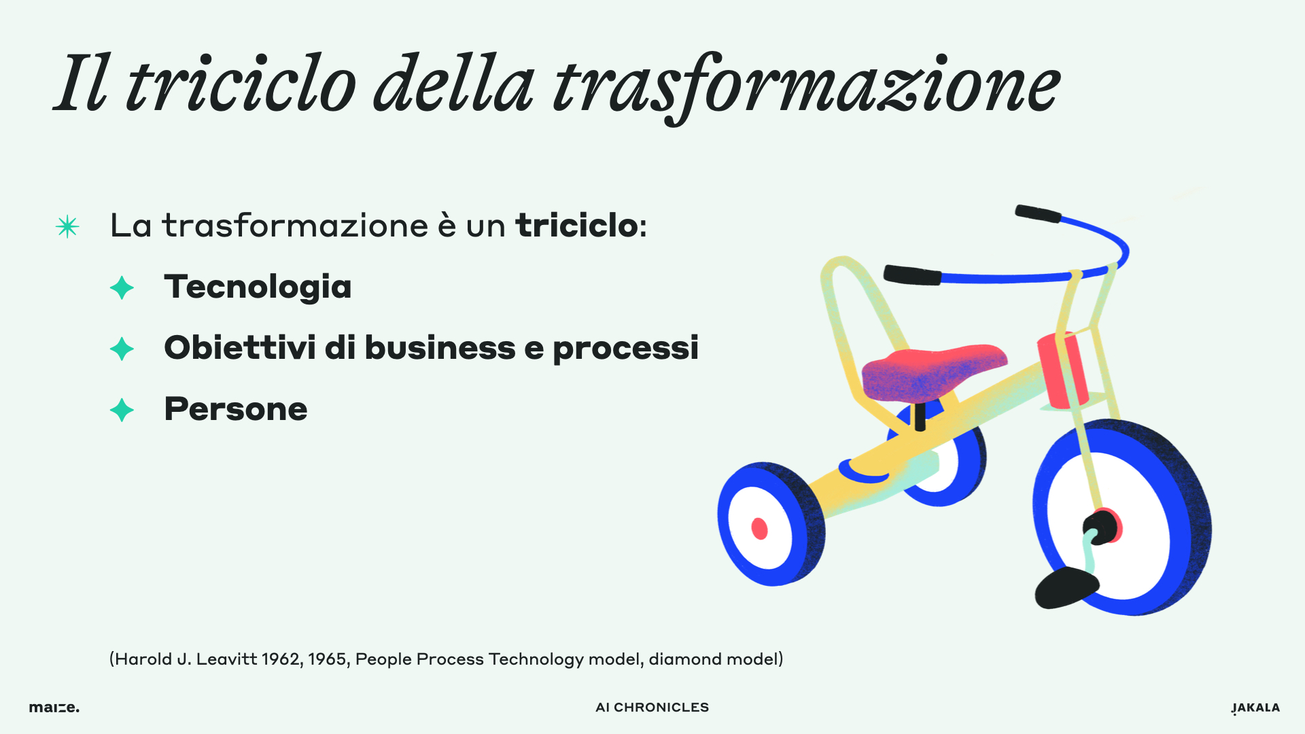

Slide 69
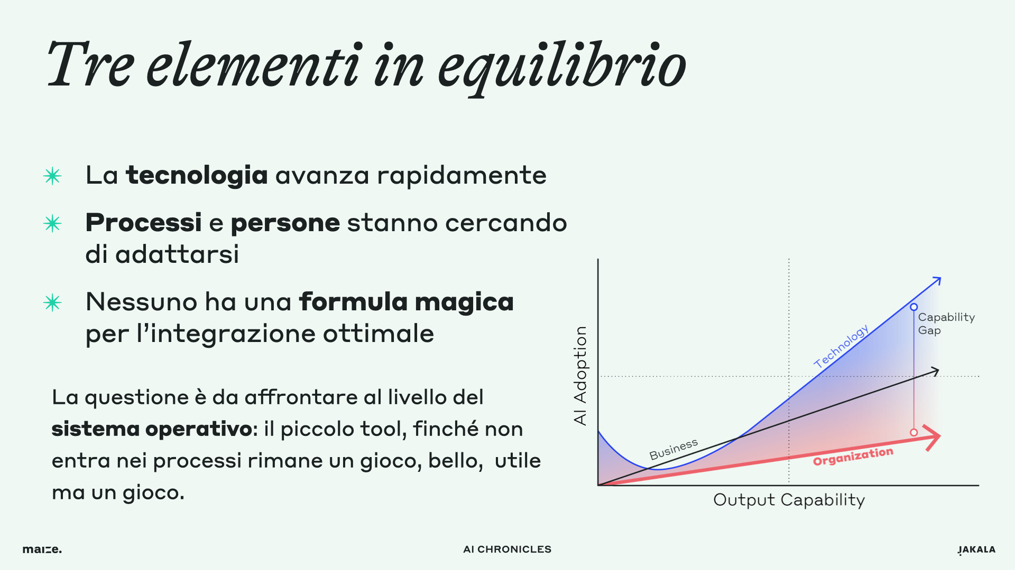

Slide 70


Slide 71


